Slide 1
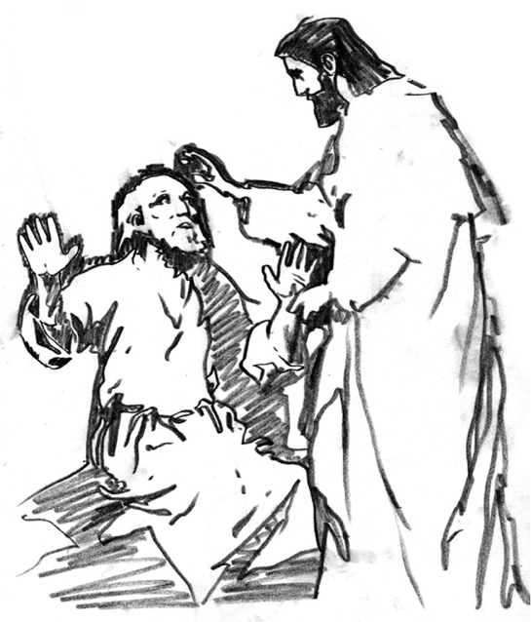
Don't the Blind Know They're Blind? John 9

Slide 2
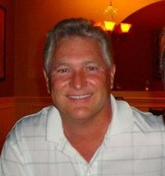
Bob Edens

Slide 3
Black

Slide 4
Bob Edens

Slide 5
Yellow

Slide 6
Red

Slide 7
Black

Slide 8
Spiritual Blindness

Slide 9
Blindness Video

Slide 10
Healing from Spiritual Blindness
forgiveness
satisfying life
eternal life

Slide 11
Black

Slide 12
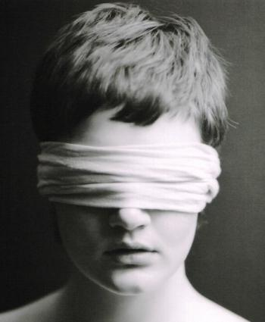
What must we see to prevent spiritual blindness— in ourselves & others?

Slide 13
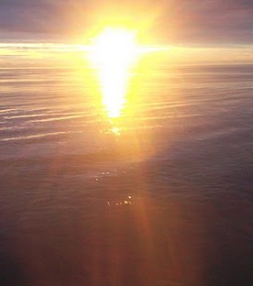
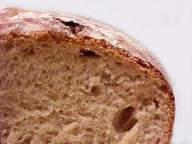
John 6–8
Bread
6
Water
7
Light
8

Slide 14
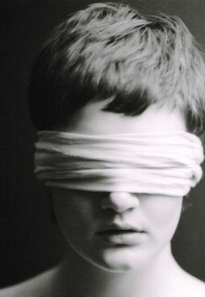
What must we see to prevent spiritual blindness— in ourselves & others?
3 views:
miracle
controversy
decision

Slide 15
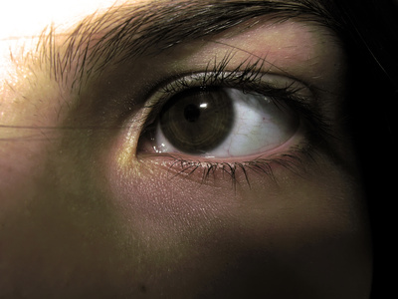
I. Jesus makes the blind see.

Slide 16
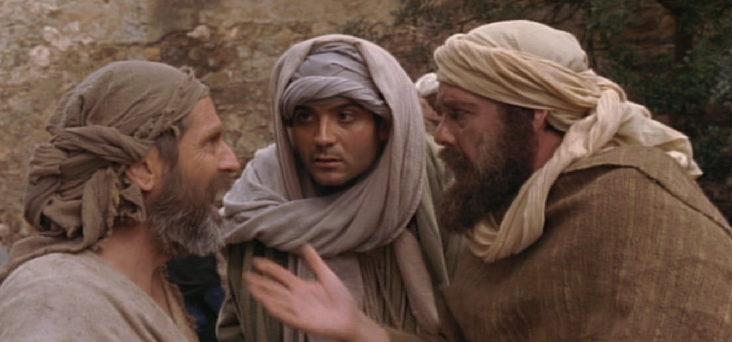
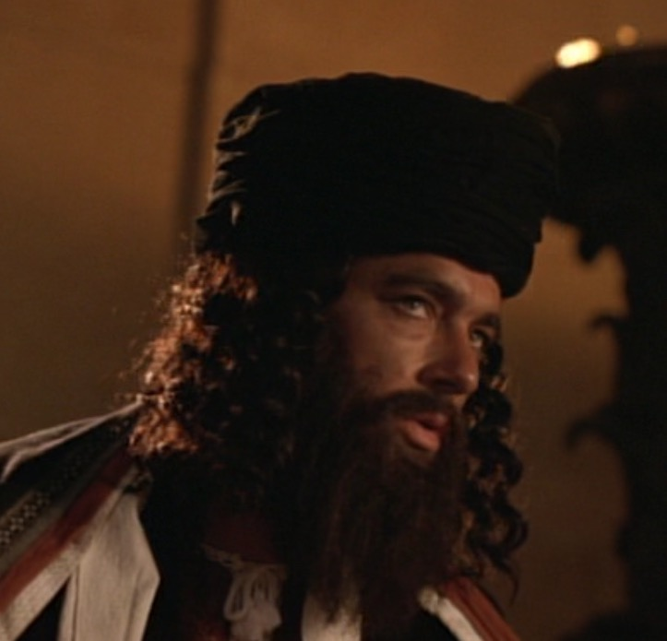
A. The blind man increasingly gained spiritual insight...
... while the Pharisees increasingly rejected his testimony and became more spiritually blind (8-34).

Slide 17
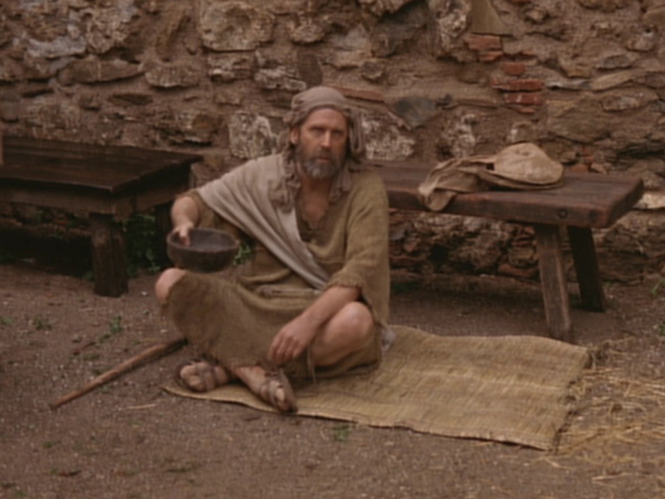
A. Jesus' healing a blind man proved he gives spiritual sight too (1-7).

Slide 18
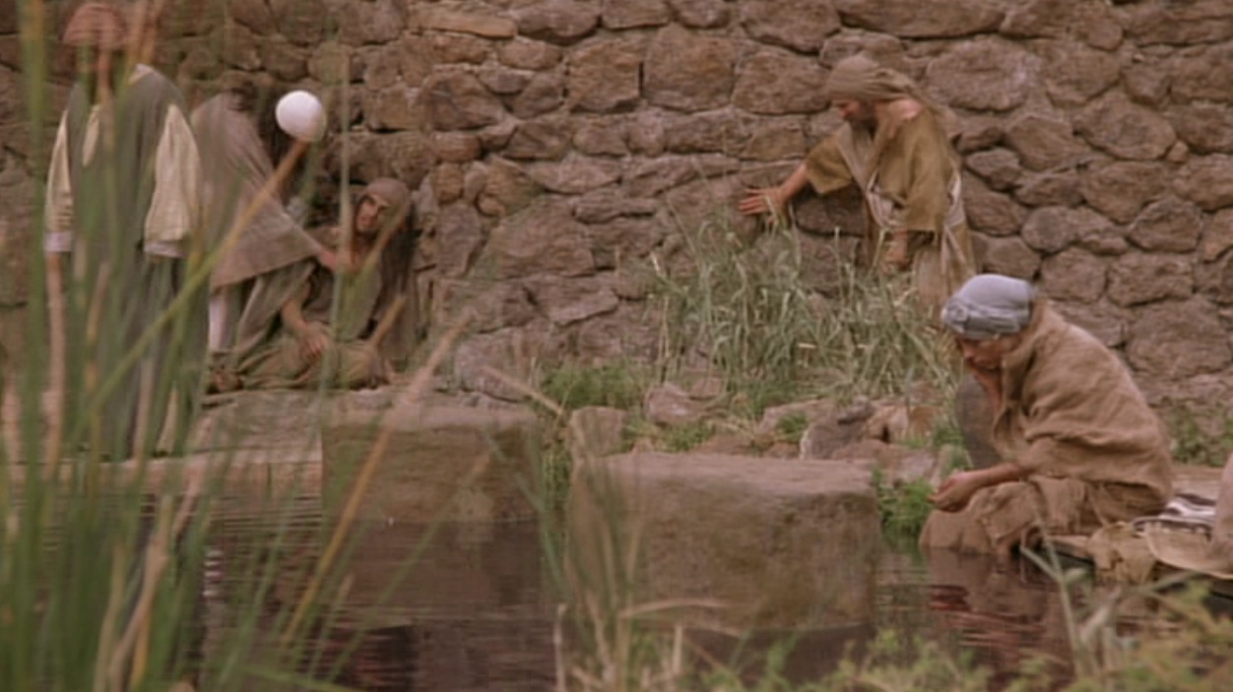
1. This man was born blind to show that God empowered Jesus to give eternal life (1-5).

Slide 19
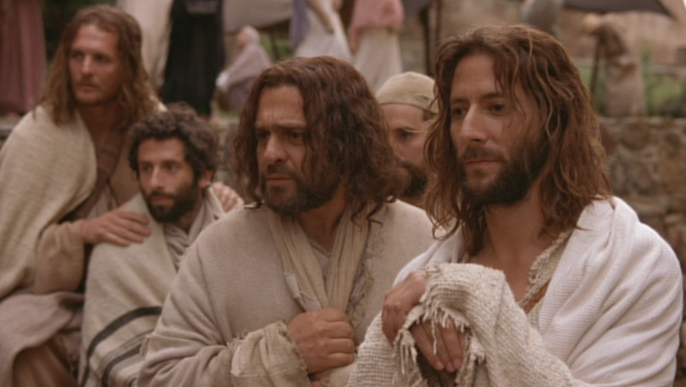
Why this blindness?

Slide 20
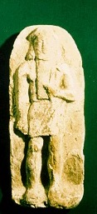
Exodus 20:4-5
Sin
“You must not make for yourself an idol.... ⁵ You must not bow down to them or worship them, for ... I lay the sins of the parents upon their children; the entire family is affected—even children in the third and fourth generations of those who reject me.'”
Suffering

Slide 21
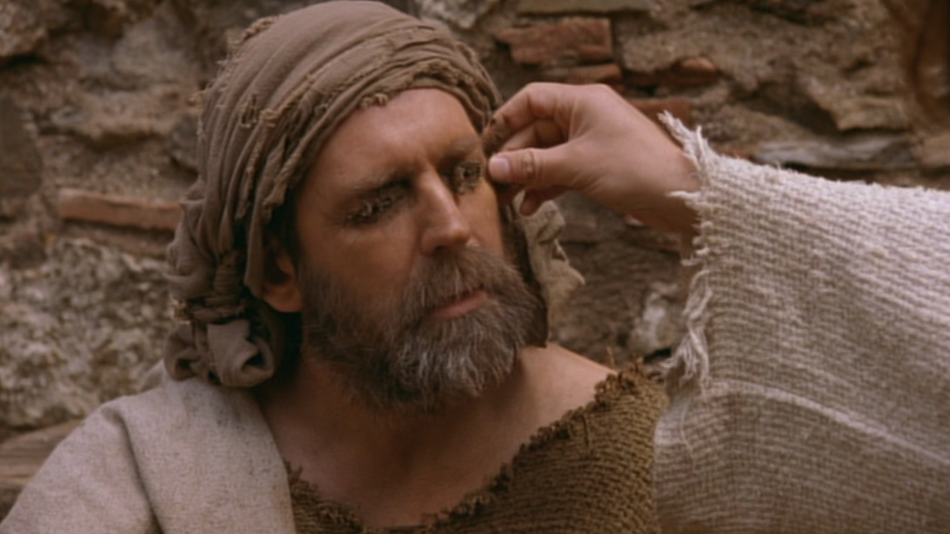
2. Jesus proved He was the way for eternal life by miraculously healing the man (6-7).

Slide 22
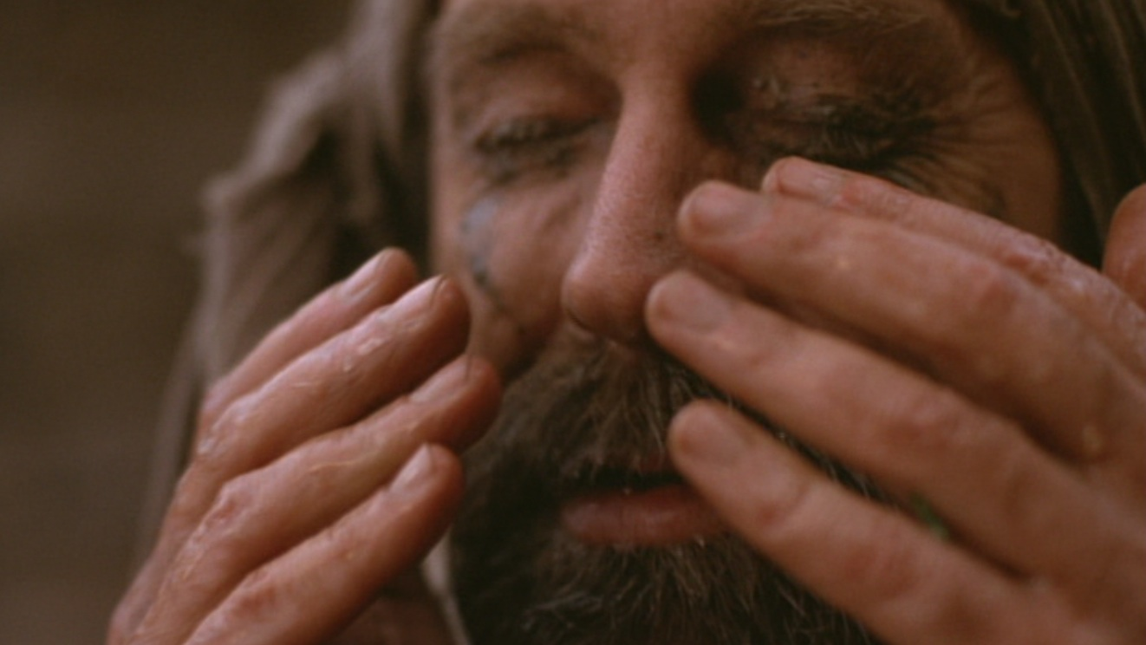
Why did Christ put mud on the man's eyes (9:6)?

Slide 23
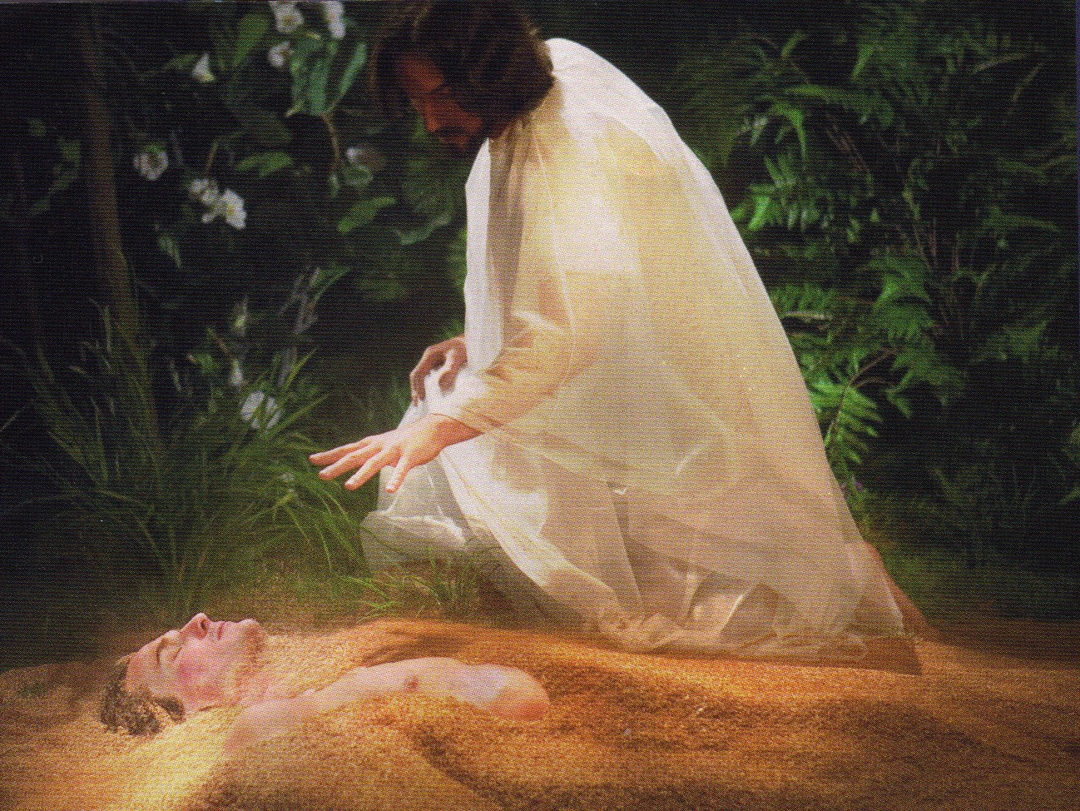
Jesus formed Adam from the dust (John 1:3; Gen. 2:7).

Slide 24
Washing developed his faith

Slide 25
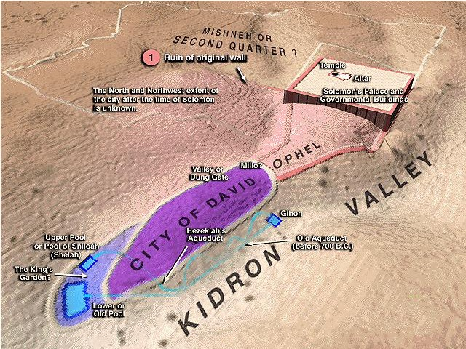
Journey to the Pool of Siloam
Temple
Pool of Siloam

Slide 26
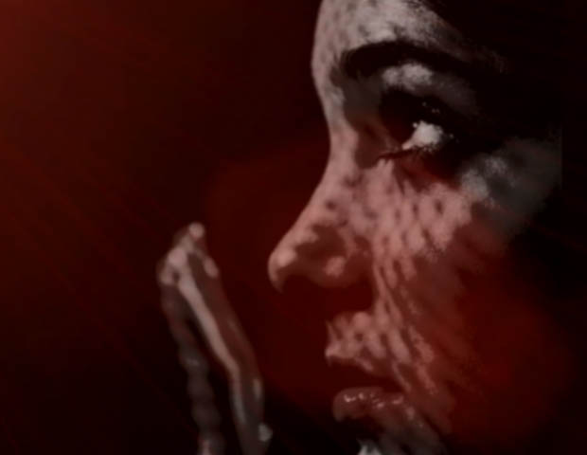
B. Do you believe that God sent Jesus to cure your own blindness?

Slide 27
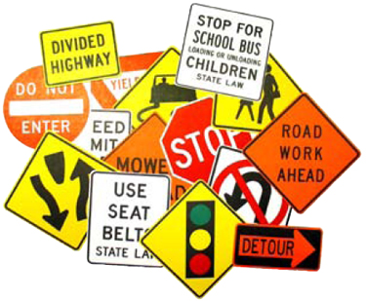
Signs in John's Gospel
Signs unique to John's Gospel in yellow (6 of the 9 miracles)
WATER TO WINE 2:1-11
HEALING OFFICIAL'S
SON 4:46-54
HEALING PARALYTIC 5:1-18
FEEDING 5000 6:1-15
WALKING ON WATER 6:16-24
HEALING BLIND MAN 9:1-7
RAISING LAZARUS 11:1-45
CHRIST'S RESURRECTION 20:1-31
FISH CATCH 21:1-3

Slide 28
I. Jesus makes the blind see.

Slide 29
II. Jesus changes people's lives (8-34).

Slide 30
A. The blind man increasingly gained spiritual insight...
... while the Pharisees increasingly rejected his testimony and became more spiritually blind (8-34).

Slide 31
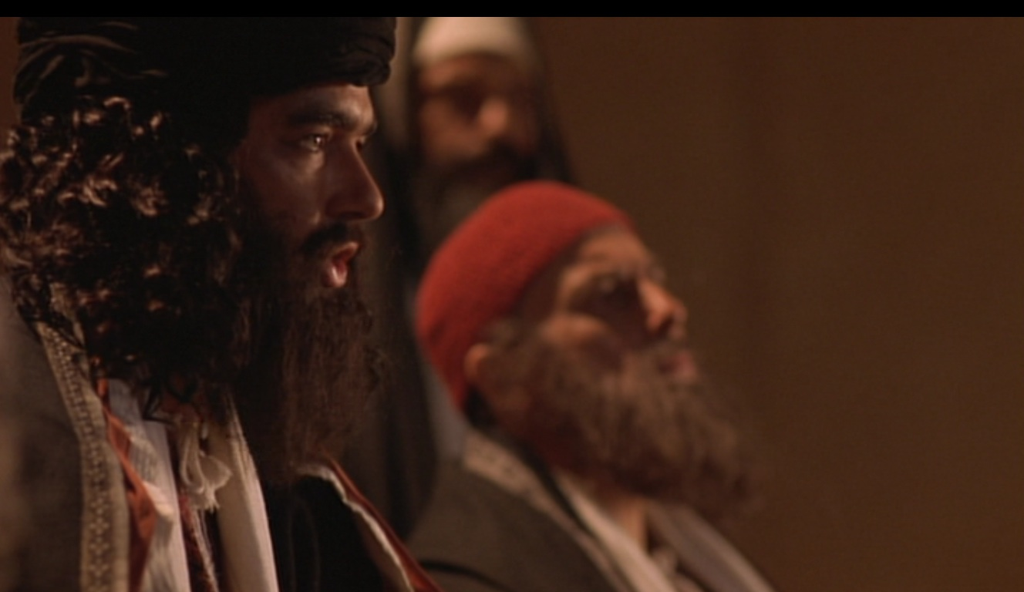
Evidence of Spiritual Blindness
Trusting rules over God's work (8-16)
“This man Jesus is not from God, for he is working on the Sabbath” (16a).
Notes:
Read 13-16a: “¹³ Then they took the man who had been blind to the Pharisees, ¹⁴ because it was on the Sabbath that Jesus had made the mud and healed him. ¹⁵ The Pharisees asked the man all about it. So he told them, “He put the mud over my eyes, and when I washed it away, I could see!”
¹⁶ Some of the Pharisees said, “This man Jesus is not from God, for he is working on the Sabbath.”
Tyndale House Publishers., Holy Bible : New Living Translation., 2nd ed. (Wheaton, Ill.: Tyndale House Publishers, 2004), Jn 9:13-16.

Slide 32
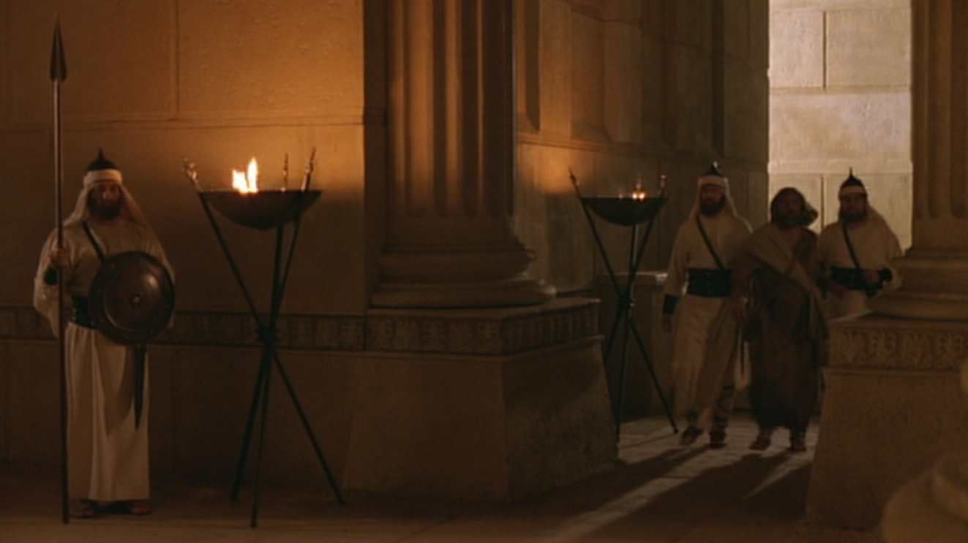
Evidence of Spiritual Blindness
Persecuting God's witnesses (17-23)

Slide 33
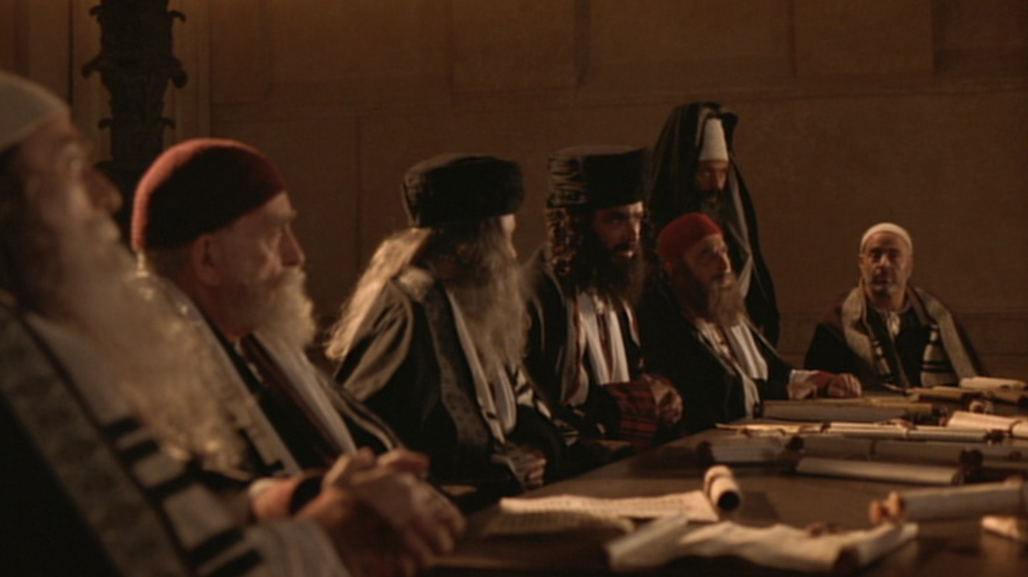
Evidence of Spiritual Blindness
Rejecting Christ despite evidence (24-34)

Slide 34
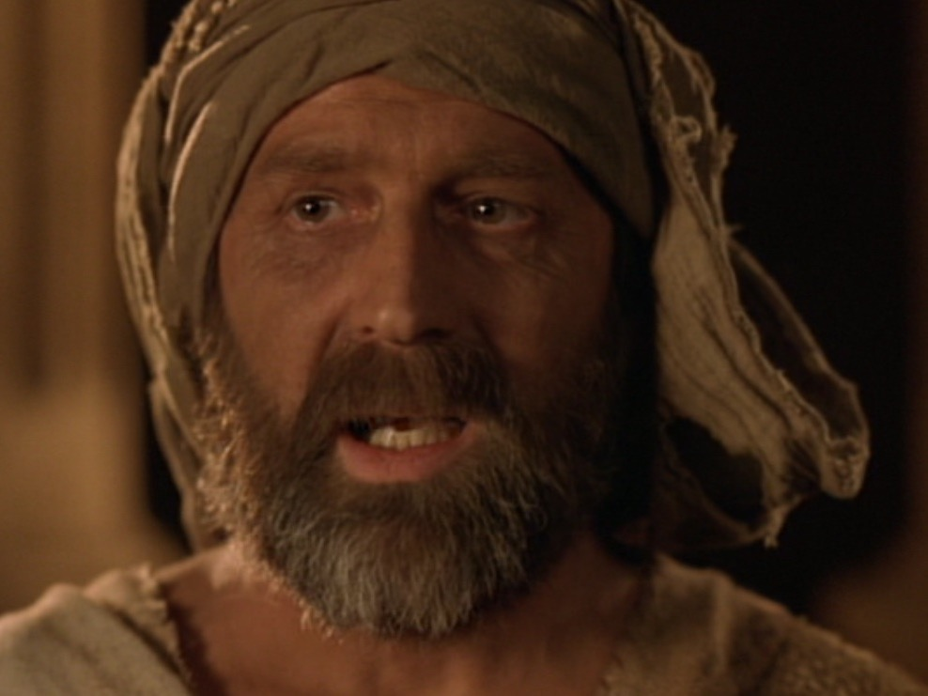
³² Ever since the world began, no one has been able to open the eyes of someone born blind. ³³ If this man were not from God, he couldn't have done it” (32-33).
^{No OT sight restored}
^{No disciples healed blindness}
Healing blindness was Christ's most common miracle!
^{Evidence of being Messiah}

Slide 35
B. Does seeing evidence for Jesus help you gain or lose spiritual insight?

Slide 36
Humility

Slide 37
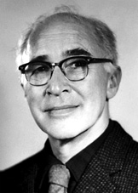
Did life originate as an accident?
“There are only two possible explanations as to how life arose: Spontaneous generation arising to evolution or a supernatural creative act of God…. There is no other possibility. Spontaneous generation was scientifically disproved 120 years ago by Louis Pasteur and others, but that just leaves us with only one other possibility… that life came as an act of supernatural creation by God, but I can't accept that philosophy because I do not want to believe in God. Therefore, I choose to believe that which I know is scientifically impossible, spontaneous generation leading to evolution.”
Dr. George Wald
Professor Emeritus of Biology, Harvard
Nobel Prize winner in Biology, 1971
Notes:
The same applies to hearing others testify that Jesus offers eternal life—we must act on the evidence by believing it to prevent spiritual blindness.
George Wald, “Origin, Lie and Evolution,” Scientific American 1978); cited by Joe White and Nicholas Comninellis, Darwin's Demise (Green Forest, AR: Master Books, 2001), 46.

Slide 38
I. Jesus makes the blind see.

Slide 39
II. Jesus changes people's lives (8-34).

Slide 40
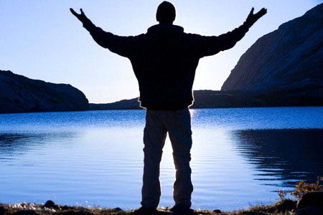
III. Jesus deserves worship as God (35-41).

Slide 41
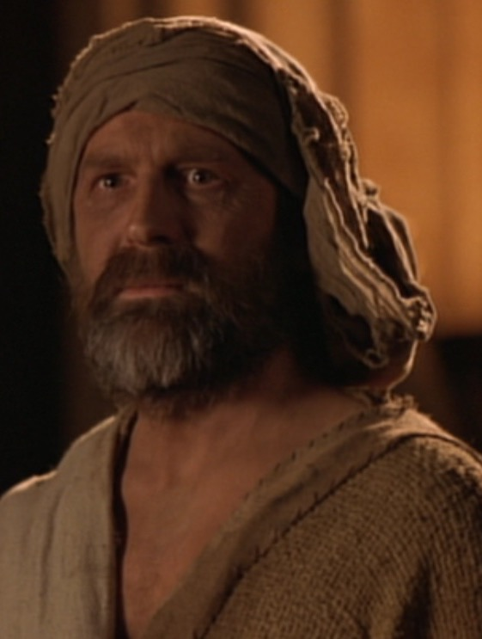
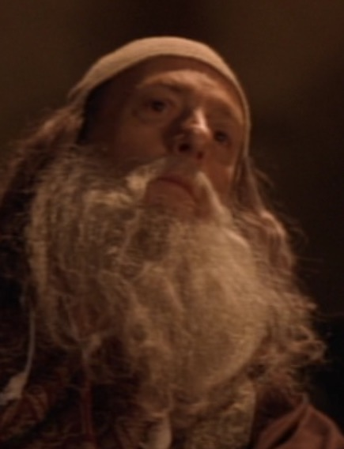
Opposite Responses

Slide 42
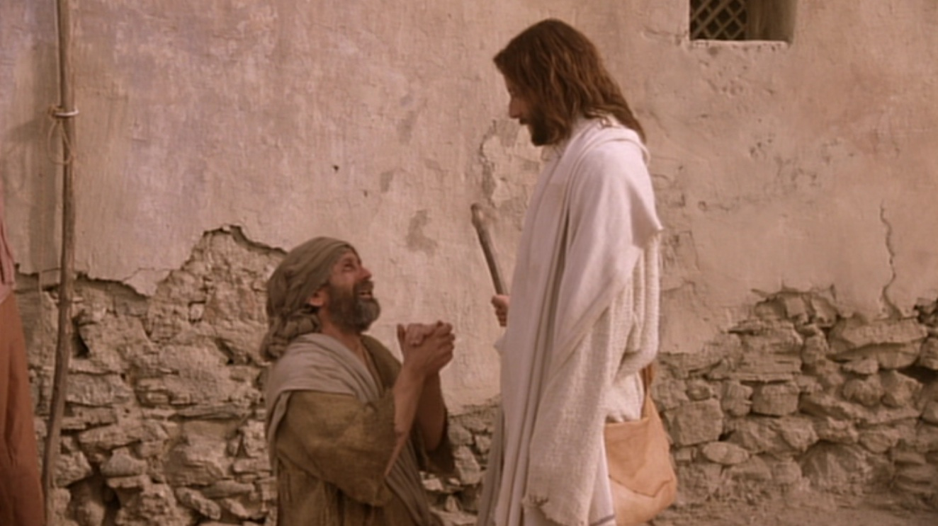
The former blind man confesses Jesus as God (35-38).

Slide 43
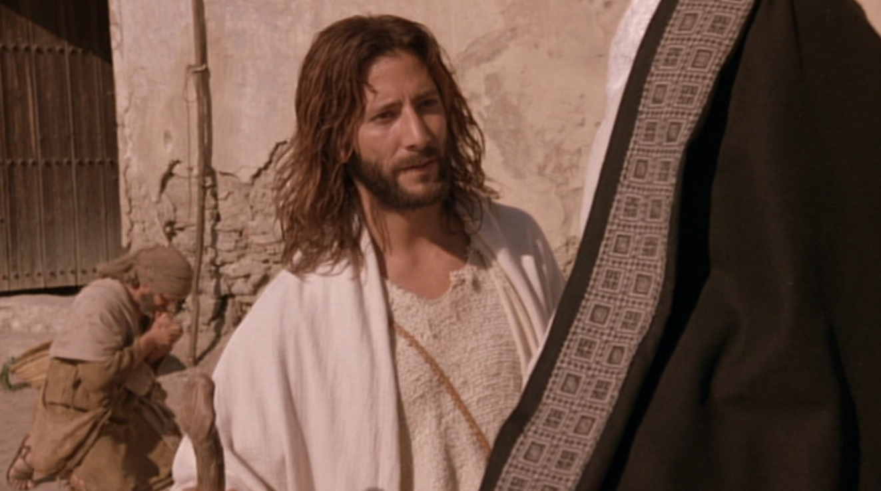
Jesus condemns the Pharisees for rejecting him as God (39-41).

Slide 44
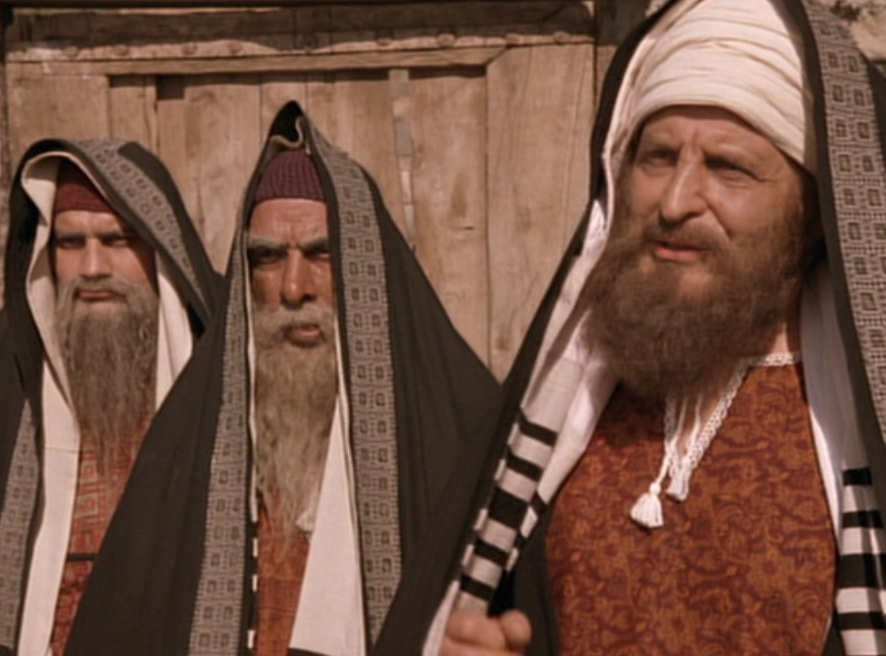
John 9:39-41 NLT
³⁹ Then Jesus told him, “I entered this world to render judgment—to give sight to the blind and to show those who think they see (Greek: “those who see”) that they are blind.” ⁴⁰ Some Pharisees who were standing nearby heard him and asked, “Are you saying we're blind?” ⁴¹ “If you were blind, you wouldn't be guilty,” Jesus replied. “But you remain guilty because you claim you can see”

Slide 45
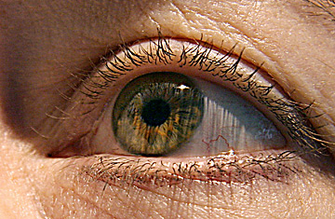
How should we respond when we see that Jesus is truly God Himself?

Slide 46
???????
Who's the real blind man?

Slide 47
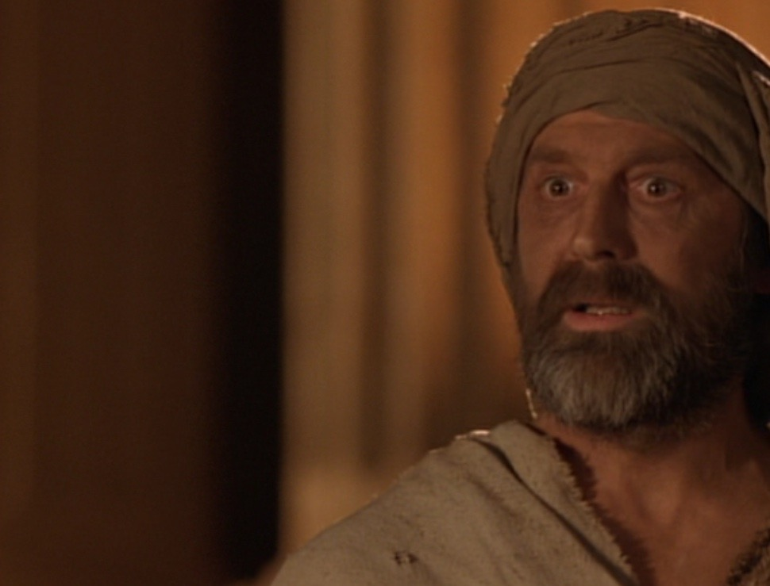
The blind man sees!
Who's the real blind man?
• God: “worshipped Jesus” (38)
• “A man from God” (33)
• “A prophet” (17)
• “A man called Jesus” (7)

Slide 48
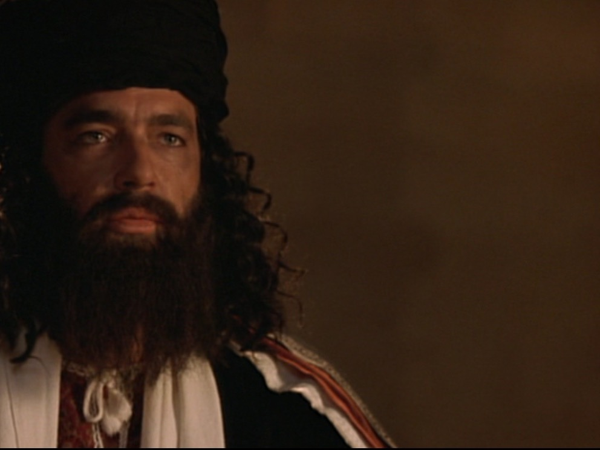
The Pharisees are blind!
Who's the real blind man?
• Jesus is a con man (15, 18)
• Jesus is a Sabbath breaker (16)
• Blind man was deceived (17)
• Parents will discredit him (19)
• Excommunication threat (22)
• Curse in God's name (24a)

Slide 49
The Pharisees are blind!
Who's the real blind man?
• Jesus is a sinner (24b)
• Jesus is a deceiver (26)
• Blind man was deceived (26)
• Cursed the blind man (28)
• Lied about Jesus' origin (29)
• Excommunicated blind man (34)

Slide 50
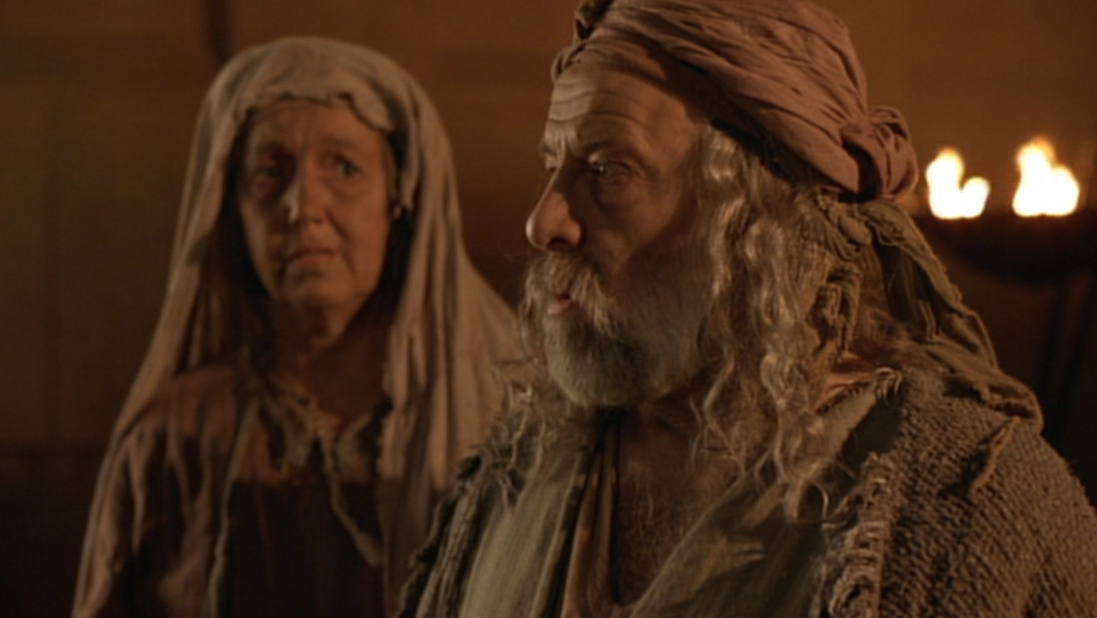
The Main Idea of John 9
How can you avoid spiritual blindness? Respond in faith to what you know now about Jesus!

Slide 51
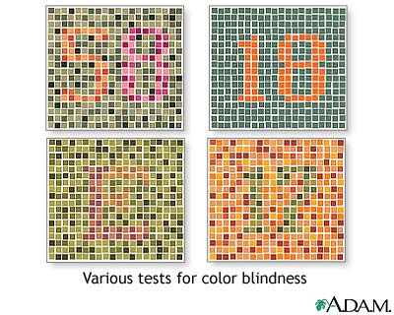
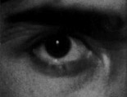
Are you color blind?
I. Jesus makes the blind see.
II. Jesus changes people's lives.
III. Jesus deserves worship as God.

Slide 52
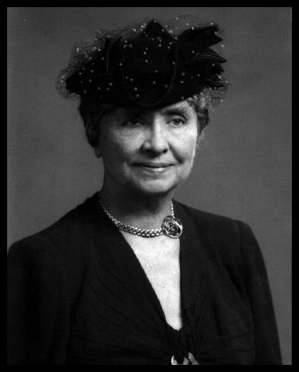
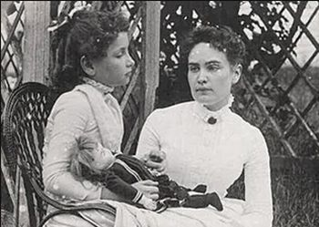
Helen Keller (1880-1968)

Slide 53
Whoever wants healing from spiritual blindness must believe that Jesus is God.

Slide 54
Black

Slide 55
Extra Slides Not Used in the Sermon...

Slide 56
Purpose #1 Jesus Healed the Blind Man
Reveal the Truth
9:1-7

Slide 57
Deity of Christ
9:1 Man born blind
We are blind spiritually at birth thus need rebirth which only God can provide
9:2-4a “Rabbi, who sinned.…? God might be displayed in Him.”
Christ's ability to cure our spiritual blindness shows him to be God
9:4b-5 Day and Night
He was sent by God to work but his work ceased during His crucifixion-resurrection

Slide 58
Deity of Christ
9:6 Mud and saliva
Irenaeus believed the action was to show Christ is the Creator (cf. Gen. 2:7)
9:7 Siloam means “Sent”
Jesus was “Sent” by God
Water symbolized the Holy Spirit so that the blind man was born of water and the Spirit (cf. 3:5)

Slide 59
What is the Truth of Verses 1-7?
Jesus is the Son of God because He was sent by God to give Spiritual Truth to the blind
“There was the true Light which coming into the world, enlightens every man” (1:9)
“Truly, truly, I say to you, unless one is born again he cannot see the kingdom of God” (3:3)

Slide 60
Purpose #2 Jesus Healed the Blind Man
Reveal the Blind
9:8-34

Slide 61
Black

Slide 62
Black

Slide 63
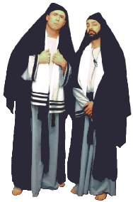
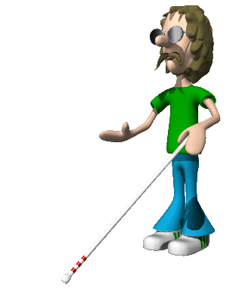
WHO WAS TRULY BLIND?
Pharisees? or the Blind Man?

Slide 64
Steps in the Blind Man's Belief
Blind man interrogated by neighbors (8-12)
Blind man and parents interrogated by Pharisees (13-23)
Blind man interrogated by Pharisees again (24-34)
“The man they call Jesus” (11)
“He is a prophet” (17)
“Whether he is a sinner or not, I don't know. One thing I do know. I was blind but now I see!” (25)
“If this man were not from God, He could do nothing”(33)

Slide 65
Steps in the Pharisees' Unbelief
“This man is not from God” (17)
“This man is a sinner” (25)
“You are His disciples but we are disciples of Moses” (29)
“You were born entirely in sin, and are you teaching us?” (34)

Slide 66
Contrasts
Blind Man
Had not seen Jesus before being healed
Knew little about the Mosaic Law
Beggar
Received Spiritual Truth
(Spiritual Sight)
Pharisees
Witnessed Jesus' miracles & teaching
Claimed to know God's Word
Religious
Rejected Spiritual Truth
(Spiritual Blindness)

Slide 67
What Caused the Blindness?
His parents were afraid of the Jews; for the Jews had already decided that anyone who acknowledged Jesus was the Christ would be put out of the synagogue (22)
“If we let him go on like this, all men will come and take away both our place and our nation” (John 11:48)
REPUTATION, PRIDE and WEALTH caused their spiritual blindness

Slide 68
Pharisees Lived in Darkness
He came to his own but those who were His own did not receive Him.
John 1:11
For everyone who does evil hates the Light, and does not come to the Light for fear that his deeds will be exposed.
John 3:20

Slide 69
Why Were They Blind?
Pharisees were spiritually blind because they rejected the testimony of the blind man and the Deity of Christ.

Slide 70
THE
OUTCOME
(35-41)

Slide 71
Outcome for the Blind Man (35-38)
The blind man could see the kingdom of God because he became born again.
The blind beggar become a child of God.
The blind man worshiped the Son of God.

Slide 72
Outcome for the Pharisees (39-41)
The Pharisees would be judged and condemned because they willfully rejected Jesus as the Son of God (39a)
The Pharisees' ability to see spiritual truth degenerated (39b)
The Pharisees continued with their guilt upon them (41b)

Slide 73
John 3:17-18
For God did not send the Son into the world to judge the world, but that the world might be saved through Him. He who believes in Him is not judged; he who does not believe has been judged already, because he has not believed in the name of the only begotten Son of God.

Slide 74
John's Message
Jesus is the Truth. Therefore…
Those who believe in Jesus shall know the truth and the truth will set them free.
But those who reject Jesus as the Son of God shall be judged.

Slide 75
Application
Let's not follow in the footsteps of the Pharisees--blinded by their pride, reputation and wealth.
Let's follow the example of the blind man--humbly obey and believe His Word.

Slide 76
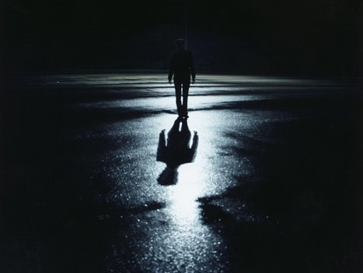
The Great Transfer
For he has rescued us from the kingdom of darkness
and transferred us into the Kingdom of his dear Son
¹⁴ who purchased our freedom and forgave our sins (Col 1:13-14)

